Slide 1
DIGITAL WHITEBOARD
Presented By,
KIRUTHIKA V

Slide 2
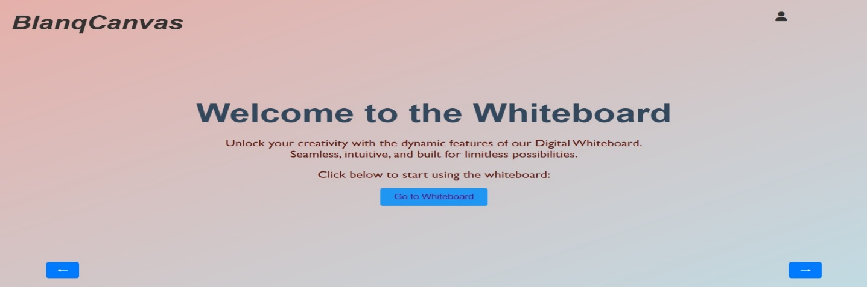
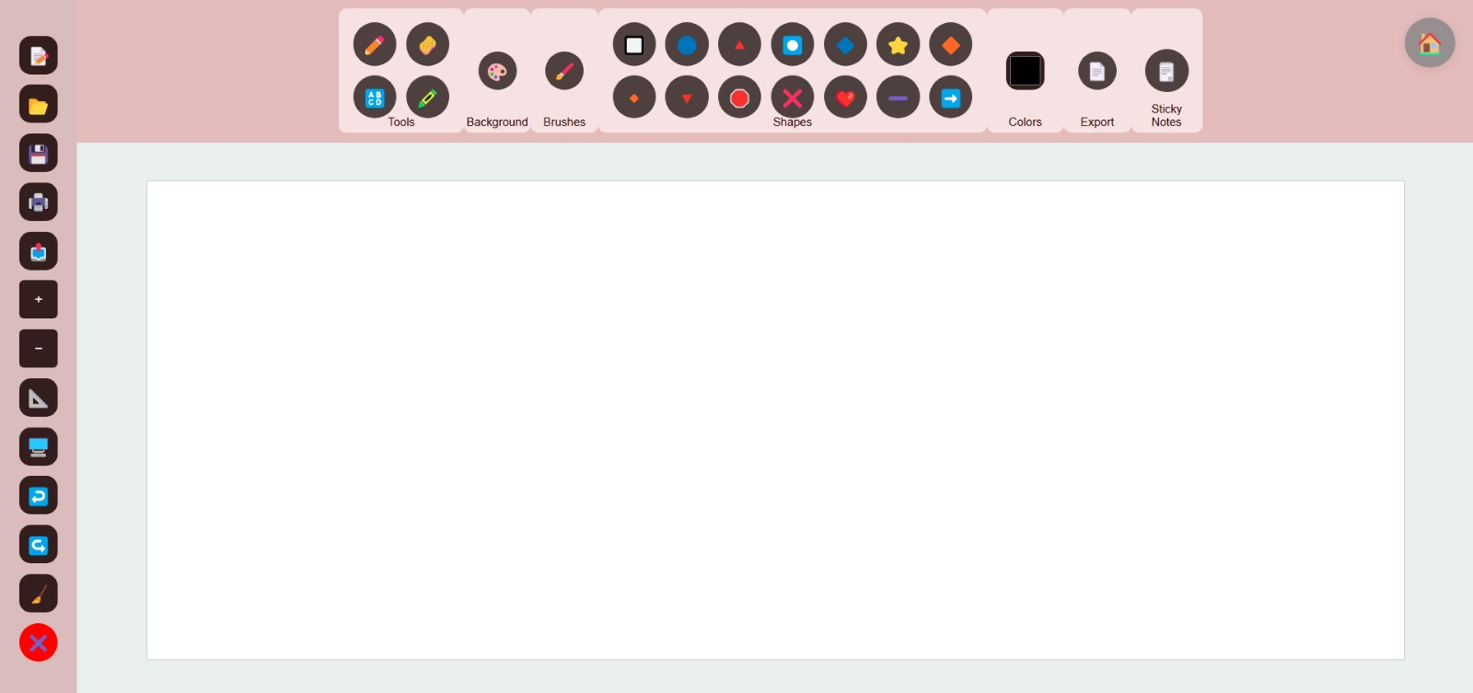
INTRODUCTION
Digital Whiteboard:
A versatile digital platform for creative
expression and collaborative work.
Enables users to draw, write, and organize ideas
seamlessly for an enhanced experience. Home page
Accessible from any device, anytime, anywhere.
Digital White Board

Slide 3
Features Overview
Drawing and erasing tools.
Shape creation and customization.
Advanced brush options.
Sticky notes, gridlines, and zoom functionalities.

Slide 4
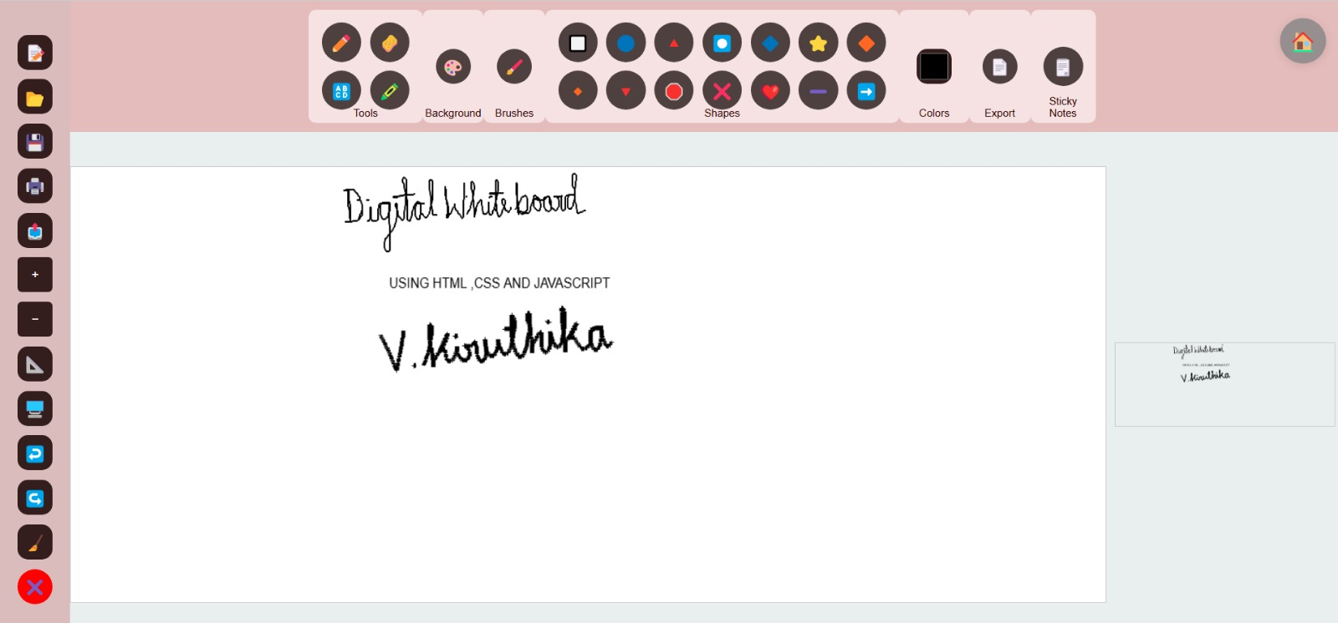
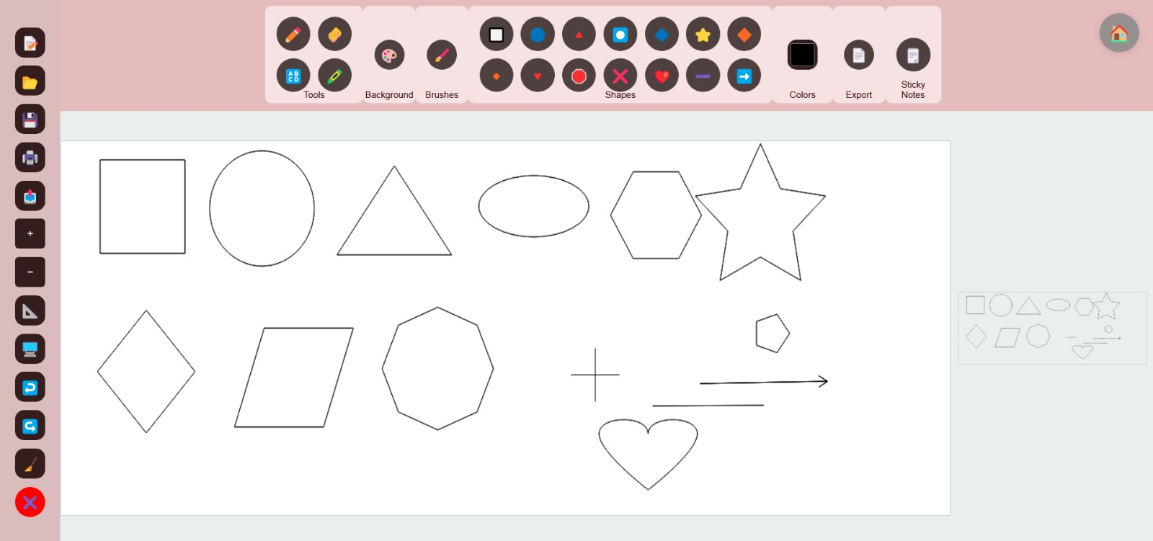
Drawing and Shape Tools
Intuitive pencil, marker, and eraser for freehand drawing.
Undo, redo, and clear options for smooth editing.
Predefined shapes and tools to create custom diagrams.
Free hand Drawing Shapes

Slide 5
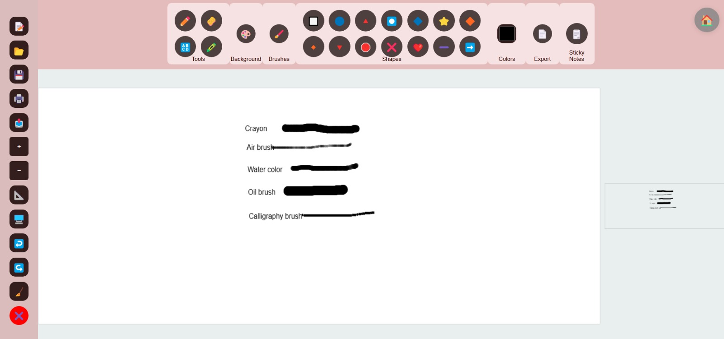
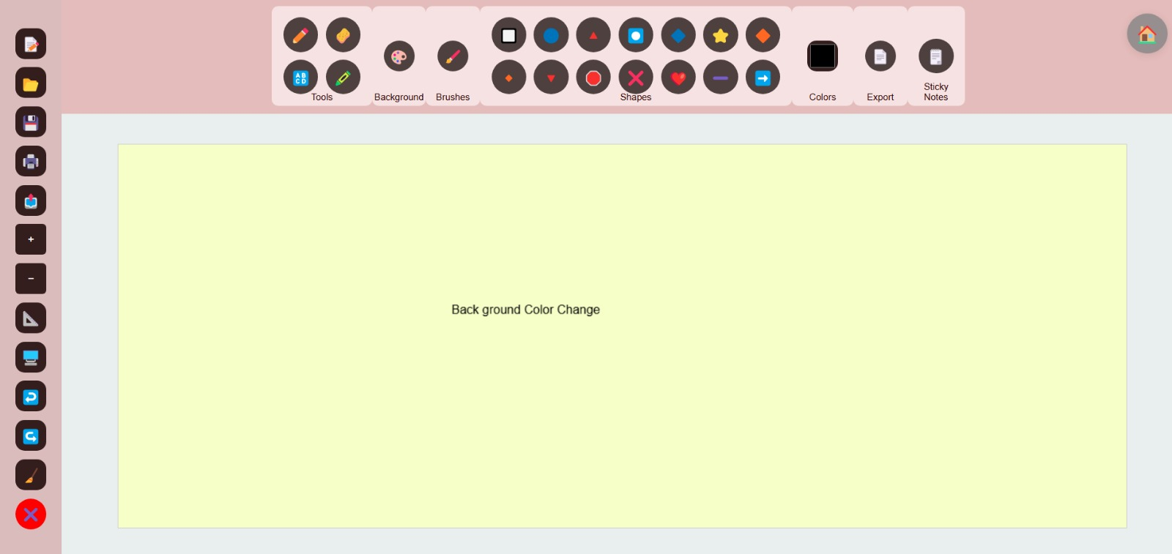
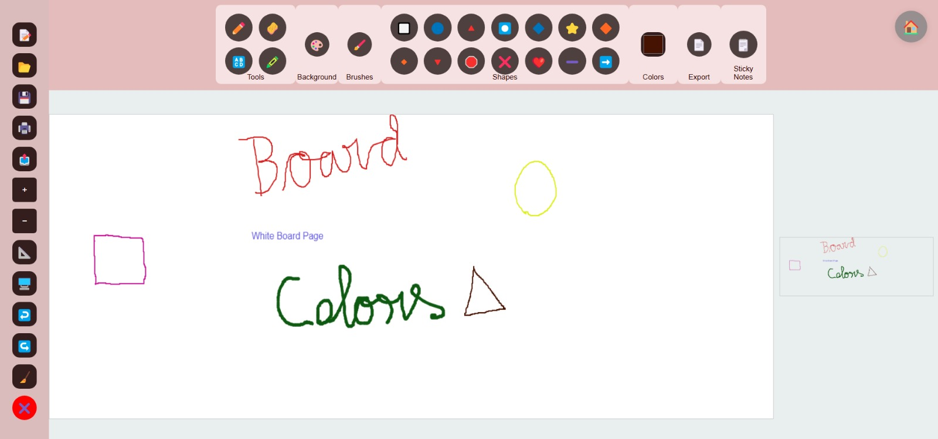
Color and Brush Customization
Multiple brush styles: watercolor, crayon, and calligraphy.
Extensive color palette for brushes and backgrounds.
Brushes Background Color Color picker

Slide 6
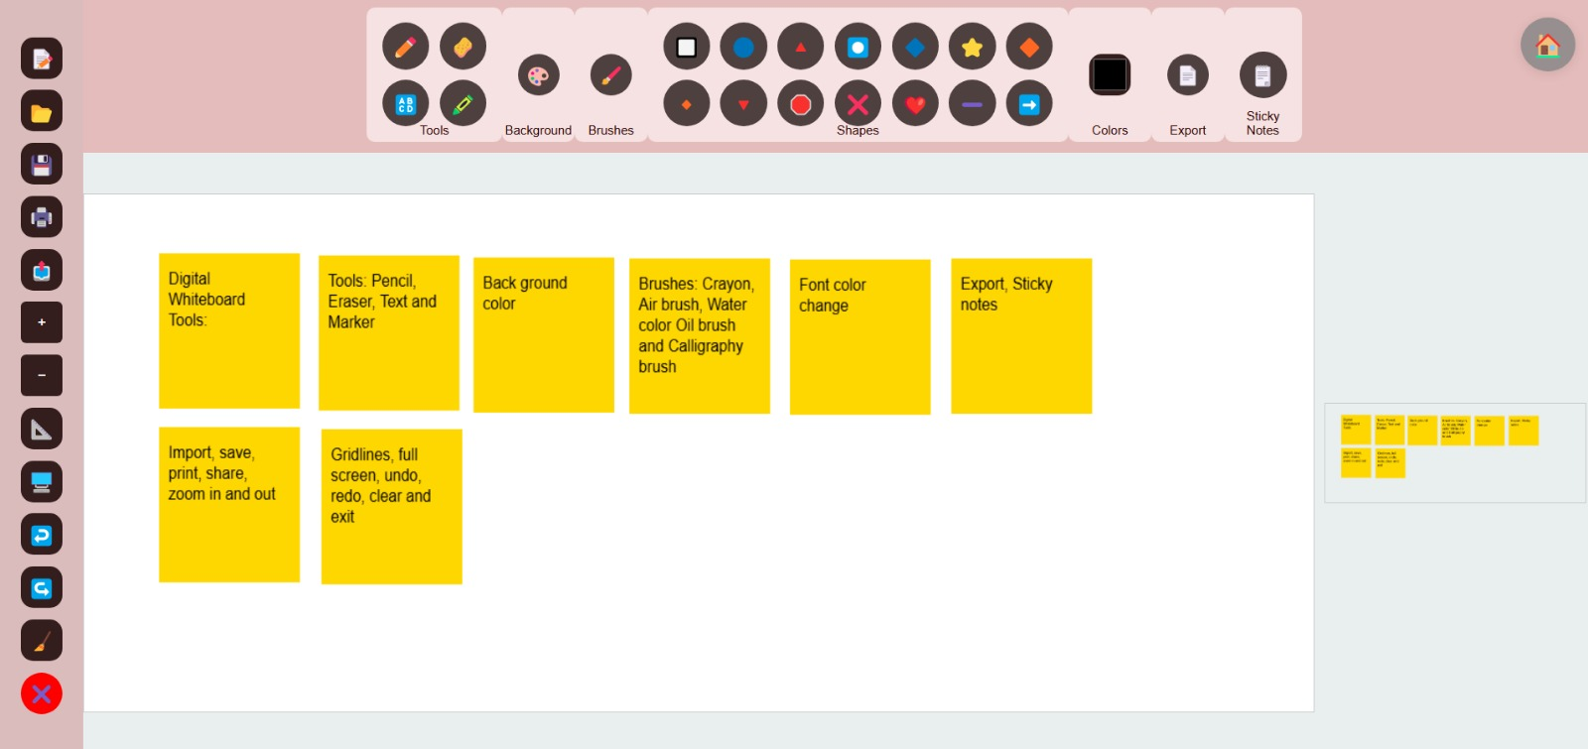
Sticky Notes and Annotations
Add sticky notes to jot down ideas.
Digital notes that users can add, move around, edit, and delete on a webpage or application.
Sticky Notes

Slide 7
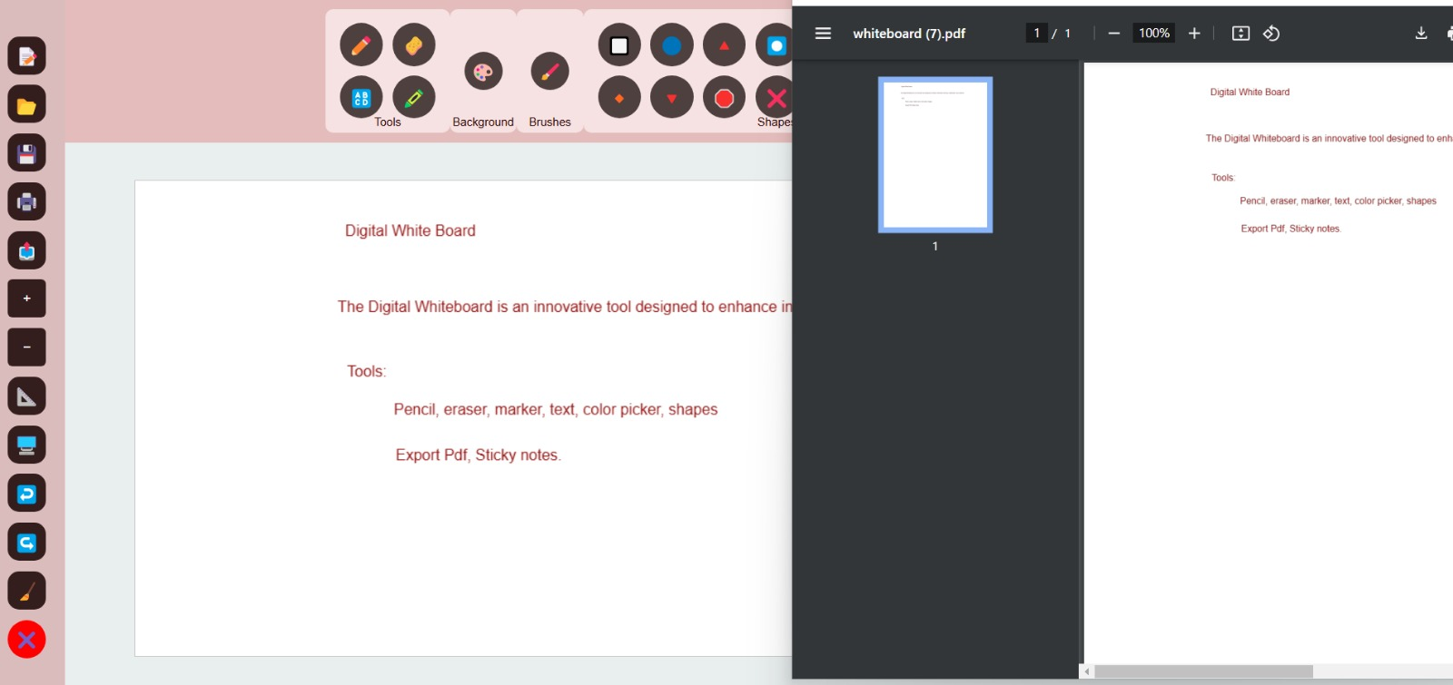
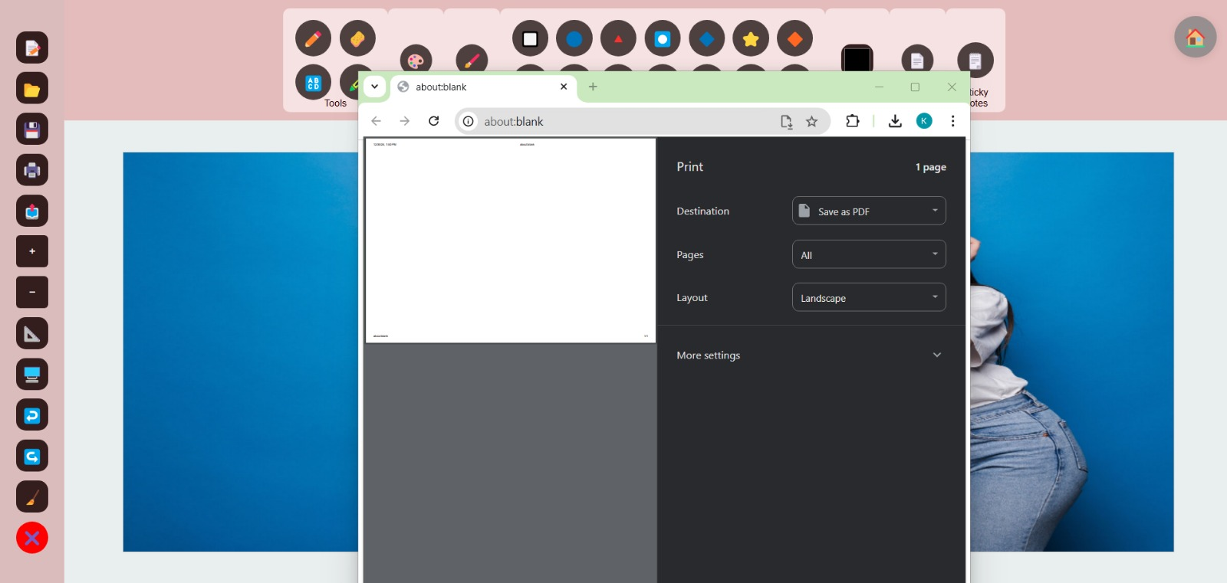
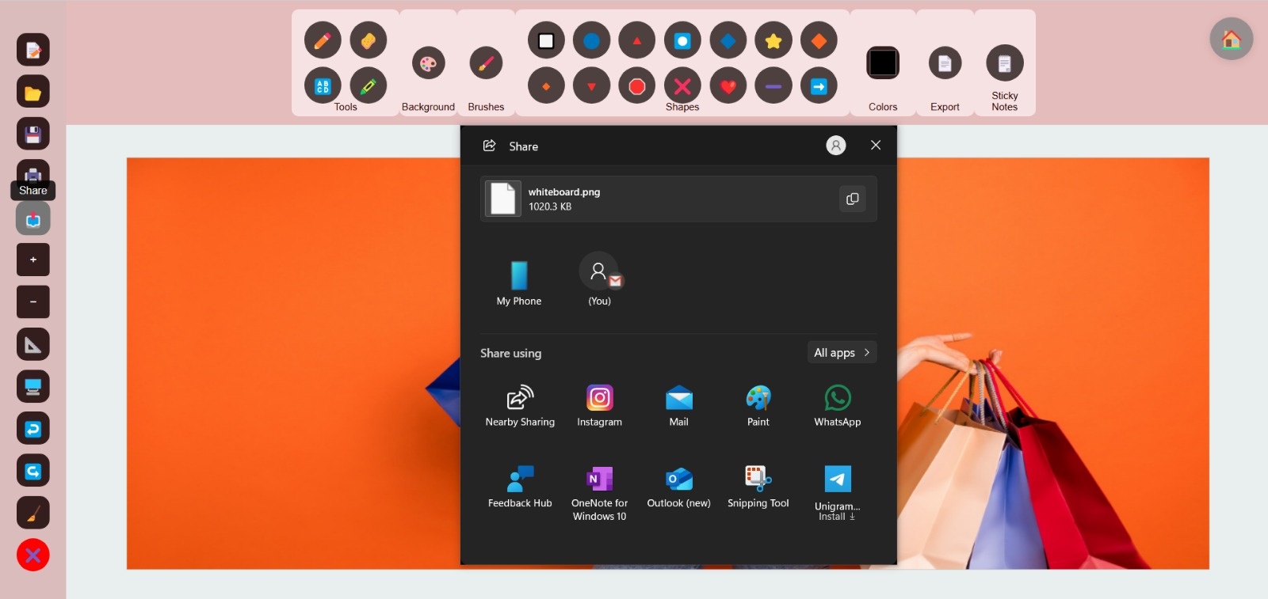
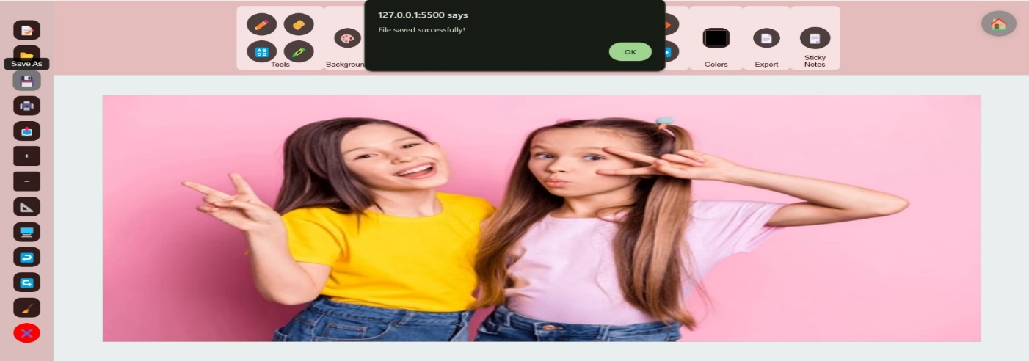
Export, Print, Share and Save Options
Export work as PDFs or save files for later use.
Easily print or share your ideas with others.
Export Print Share Save

Slide 8
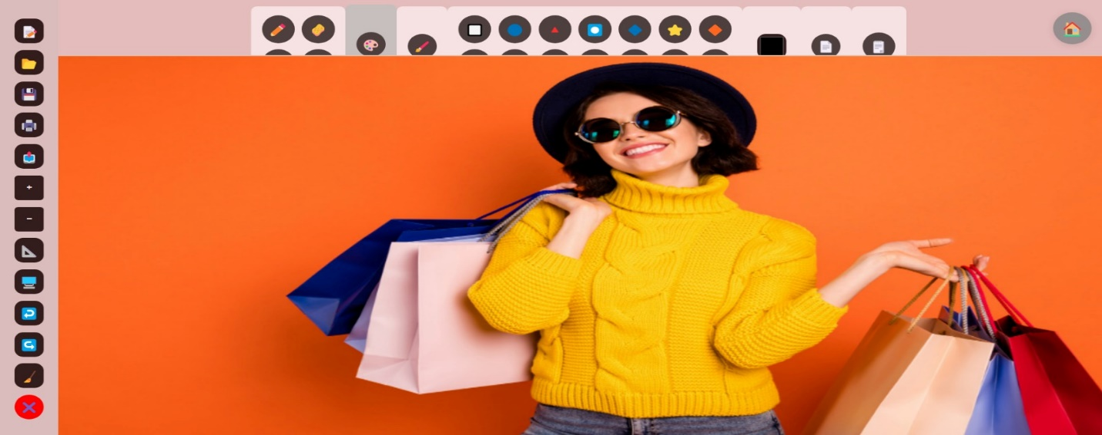
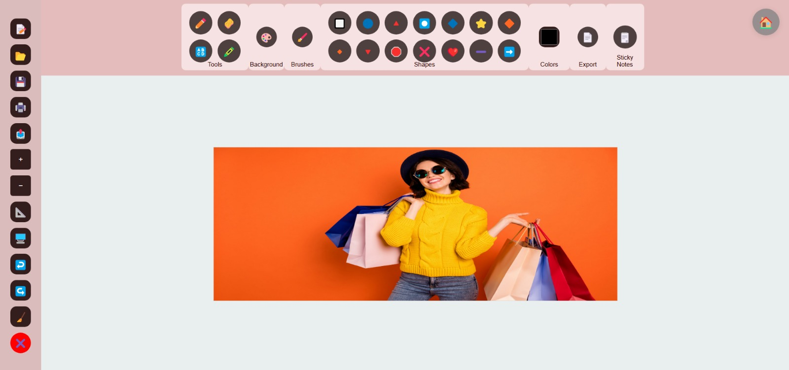
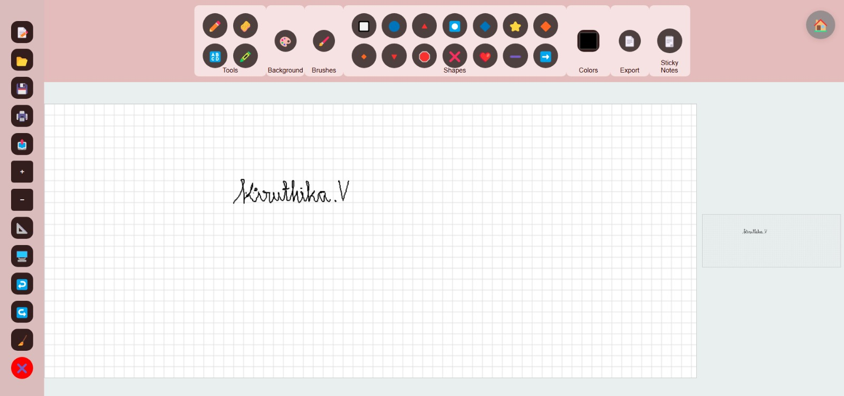
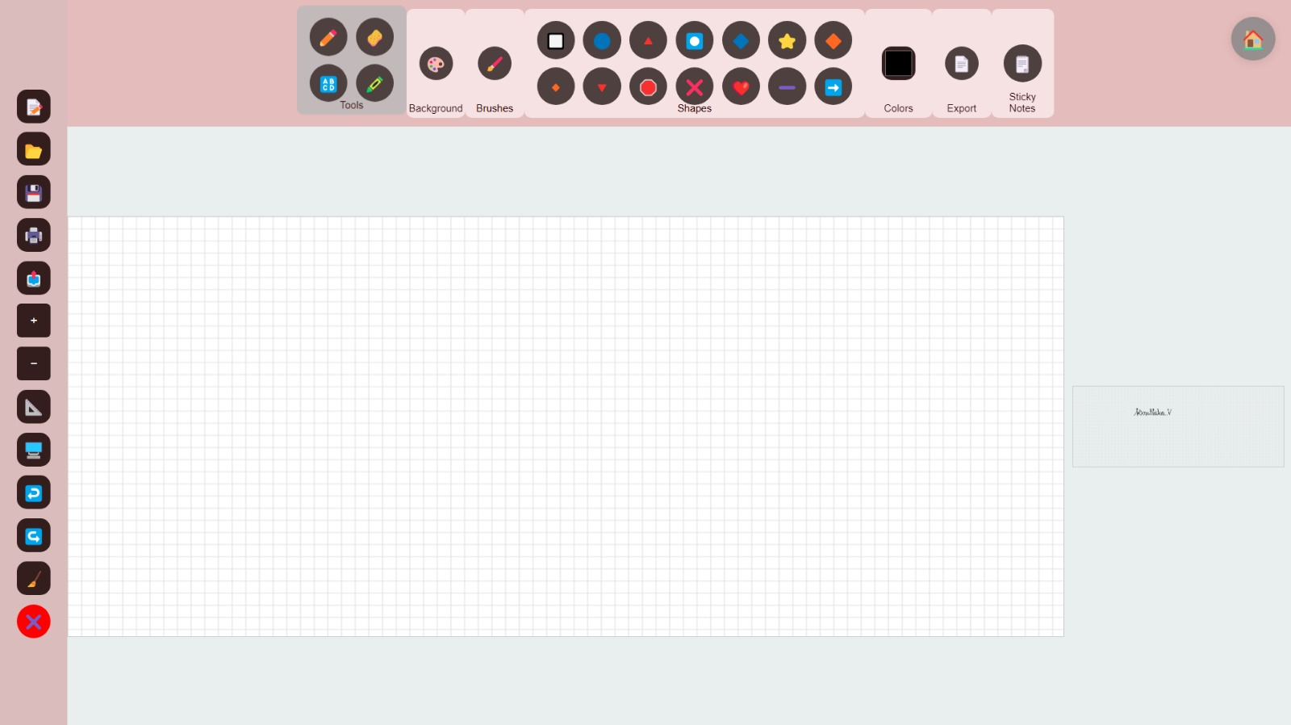
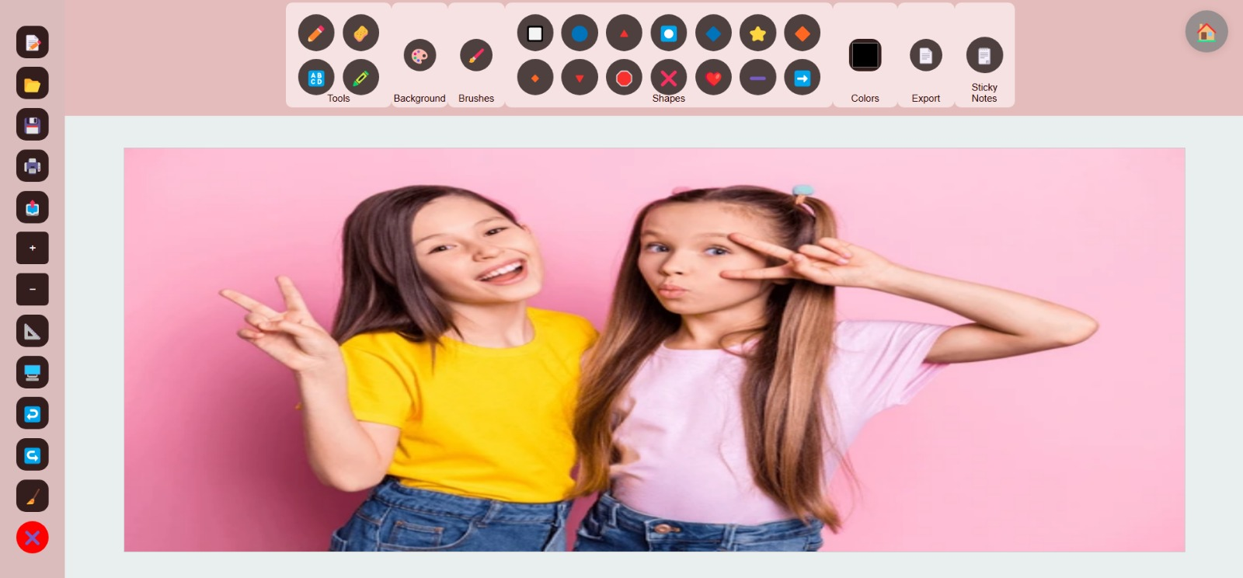
Zoom, Gridlines, Full screen, Import
Zoom in/out for detailed designs or broader views.
Enable gridlines for precise alignments and full-screen mode for an immersive experience.
Import external files (images) directly into the whiteboard.
Zoom in Zoom out Gridlines Full Screen Import

Slide 9
Use Cases
Who Can Benefit?
Students: Visual learning and assignments.
Designers: Sketching and prototyping.
Educators: Interactive teaching.

Slide 10
Conclusion
The Digital Whiteboard project successfully combines interactive drawing tools, a user-friendly interface, and a range of customizable features to provide a versatile platform for digital collaboration and creative expression.

Slide 11
THANK YOU

